Slide 2
About Hongfa
Electrical Vehicle Charging
Energy Storage
Questions & Discussion

Slide 3

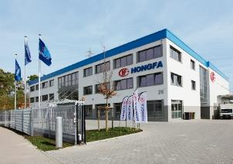




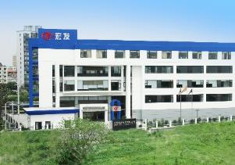



About Hongfa
Hongfa is a leading company in global relay industry, founded in 1984.
Hongfa provides multiple products such as relays, low voltage devices, high and low voltage panels, connectors, capacitors, precision parts and automation equipment.
With more than 30 subsidiaries, it has established three R&D and production bases in Xiamen, Zhangzhou, Eastern and Western China, leveraging the advantages of the entire industrial chain of relays and associated products.
Group Revenue Growth Trend
2.3billion USD
2.0billion USD
Hongfa has been developing at a high speed for more than 30 years, and its economic growth has always maintained a good development trend.
Sales & Support Network around the world
India、Korea、Philippines、Turkey、Brazil
Xiamen(HQ)
Hongfa Europe
Hongfa America
KG Techn.
Hong
Kong
Beijing
Shanghai
Sichuan
Zhejiang

Slide 4
EV charging

Slide 5


EV Charging
Charging Modes
Standardized plug-in device, eg. a household outlet
In a 1 or 3-phase network
The maximum charging current is 16 A
No communication with vehicle
1
MODE
AC
The charging cable is protected by IC-CPD (In-Cable Control and protective Device).
Protect against fault currents
Communicates with the vehicle.
The maximum charging current is 1ph 16A, 3ph 32A
2
MODE
AC
COM

Slide 6
EV Charging
Charging Modes
Charge with a charging station or at a wall terminal Communication with the vehicle and Three-phase current up to 63 A
Type A: A fixed charging cable, connected to the vehicle
Type B: Movable AC charging cable, with connector at each end
Type C: cable fixed connection to charging station
3
MODE
Level 2
AC
COM
High-speed, High power, Fast charging
Communication with vehicle
AC / DC converter is installed in the charging station (OBC is bypassed)
Contacts and the cable sections are larger
Power transmission up to 250 kW
4
MODE
Level 3
DC
COM

Slide 7
EV Charging
OBC module in EV
Glav
isolation
Block diagram
~
L1
L2
L3
N
PE
DC+
EMI FILTER
PFC+RECT
HV
DC-DC
HV-net
/Bat
=
DC-
chassis
A
Switchting Matrix
B
C
N

Slide 8
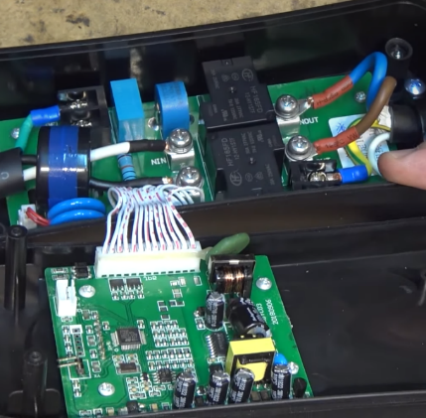
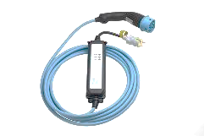
EV Charging
Charging Mode 2
Max Power:
1 Phase(s): 250Vac 16A → 4kW
3 Phase(s): 400Vac 32A → 22kW
Applicable Hongfa Products:
Power Relays
Terminal Blocks
Film Capacitors
Current Transformer

Slide 9
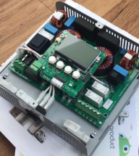
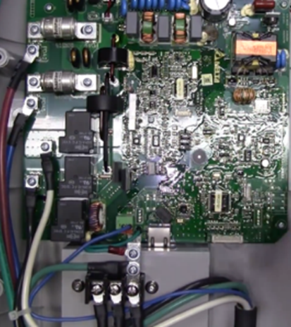
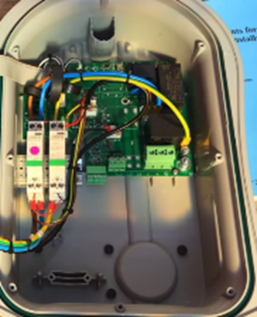
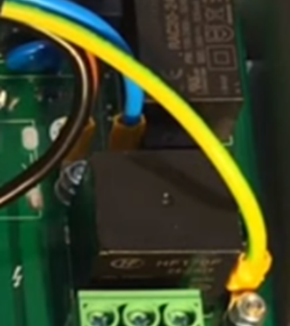
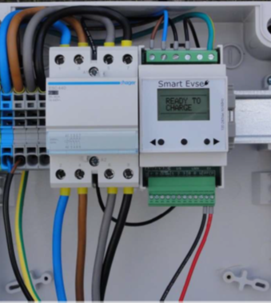
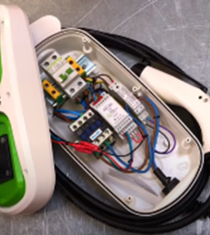
EV Charging
Charging Mode 3
Design 1
Use relays and control board
Rely on existing electric installation of MCB RCBO
Hongfa Products:
Power Relays (16A to 32A)
Terminal Blocks
Capacitor
Design 2
Use relays and control board
Rely on existing electric installation of MCB RCBO
Hongfa Products:
Relays
Terminal Blocks
MCB
Design 3
RCBO and contactor
Integr. DC residual current monitoring module & charging mode 3 controller
Hongfa Products:
Contactors
Terminal Blocks

Slide 10
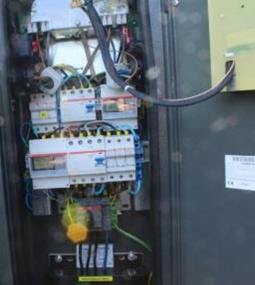
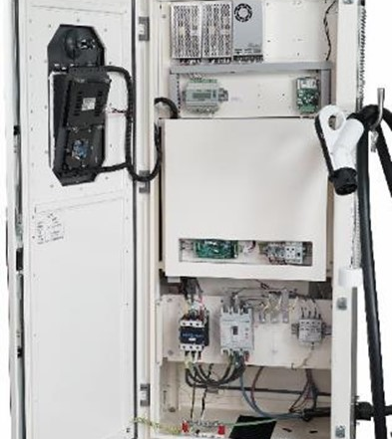
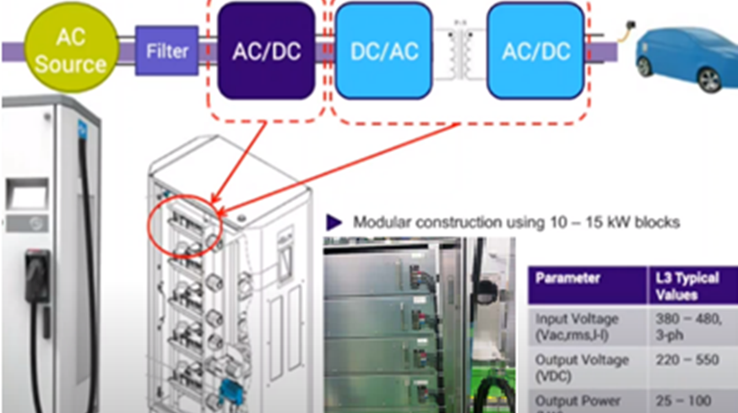
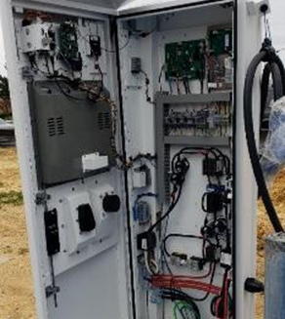
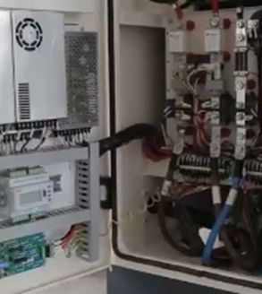
EV Charging
Charging Mode 3 & 4
Mode 3 - Max Power
63A / 43.5 kW
Hongfa Products:
Contactors
MCB / MCCB
Power Relay
Capacitor
Mode 4
Include 20 kW subunits and stack them to create a higher power
Three main power levels:
  ≤ 50kW for city use
  150 kW for highways
  350 kW for supercars/Trucks/Buses
Hongfa Products:
Contactors
MCCB
HVDC Relays
Terminal Blocks
Power Relays

Slide 11

EV Charging
Standards involved
HD6034-7-722:2018
61851-1
62752
62955
61439-1-7:2020
61810-1
In-cable control and protection device for mode 2 charging of electric road vehicles (IC-CPD)
Residual direct current detecting device (RDC-DD) to be used for mode 3 charging of electric vehicles
Low-voltage switch- and control gear assemblies
60664-1
Electric vehicle conductive charging system
Part 1: General requirements
Insulation coordination for equipment within low-voltage systems
Part 1: principles, requirements and tests
For all modes
For mode 2
For mode 3
For all modes
Contact gap /
Clearance/creepage

Slide 12
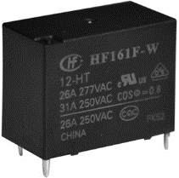
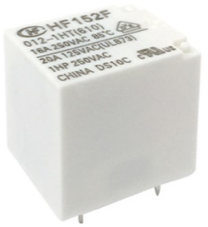
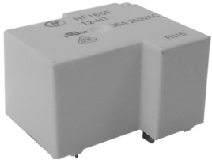
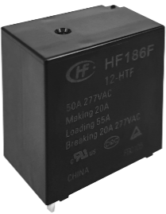
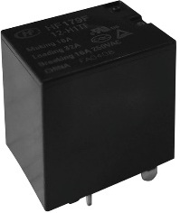
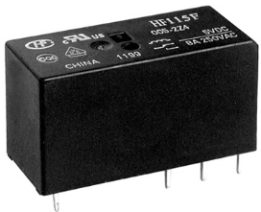
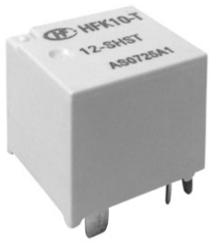
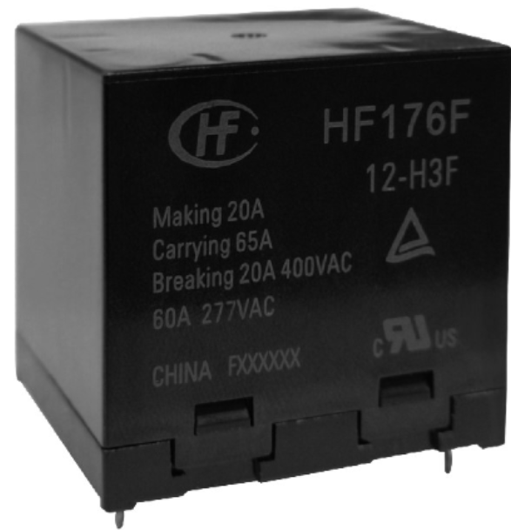
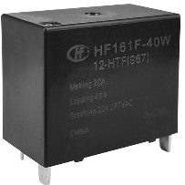
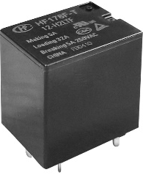
EV Charging
Power Relay – Single Pole, Contact form 1A/1C
HF152F
21×16×20.6
HFK11(-T) C16
20.5 x 15.9 x 20.6
HF161F-W
30.4×15.9×23.3
HF165F
32.2×27.4×19.4
HFK11(-T) C32
20.5 x 15.9 x 20.6
HF186F
30x20x31
*1.5mm to 2.3mm
HF179F
21.5×16×20.6
*1.8mm to 2.0mm
*3.0mm
HF115F/K
29.0×12.7×15.7
HFK10(-T) C16
18.85×15.9×16.5
HF161F-40W
30.4×15.9×23.3
HFK10(-T) C32
18.85×15.9×16.5
HF176F
38×33×36.8
*1.8mm to 2.4mm
HF178F(-T)
21.5×16×20.6
*2.0mm
*3.0mm
16A
20A
32A
40A
45A
65A
Current
*contact gap

Slide 13
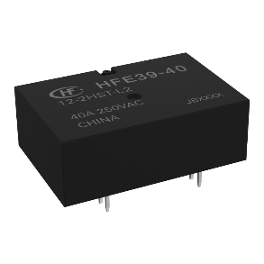
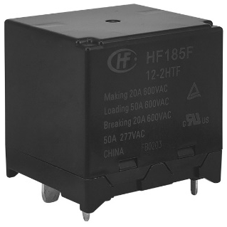
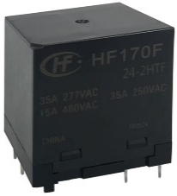
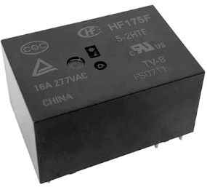
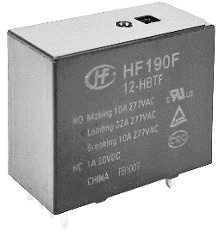
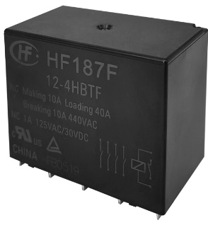
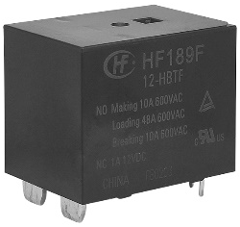
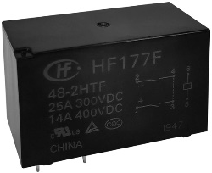

EV Charging
Hongfa Power Relays
HFE39-40/2P
30x20x10.2
HF170F/2P
36 × 30 × 40
HF185F 2P
40x35x38.8
Single pole w/ aux contact
2 poles w/ & w/o aux contact
4 poles w/ aux contact
*Latching
*3.6mm, aux contact
*3.0mm
HF175F 2P
29.0×19.6×15.7
HF190F 1P
35 x 16 x 28
HF177F 2P
50×25×31
HF187F(955) 4H1D
59 × 35 × 47
HF189F 1P
35x25x28
3kA SCC
3kA SCC
*for AC load
*3.9mm, aux contact
*2.25mm, aux contact
62955 compliant
*2.25mm, aux contact
16A
32A
40A
50A
*contact gap

Slide 14
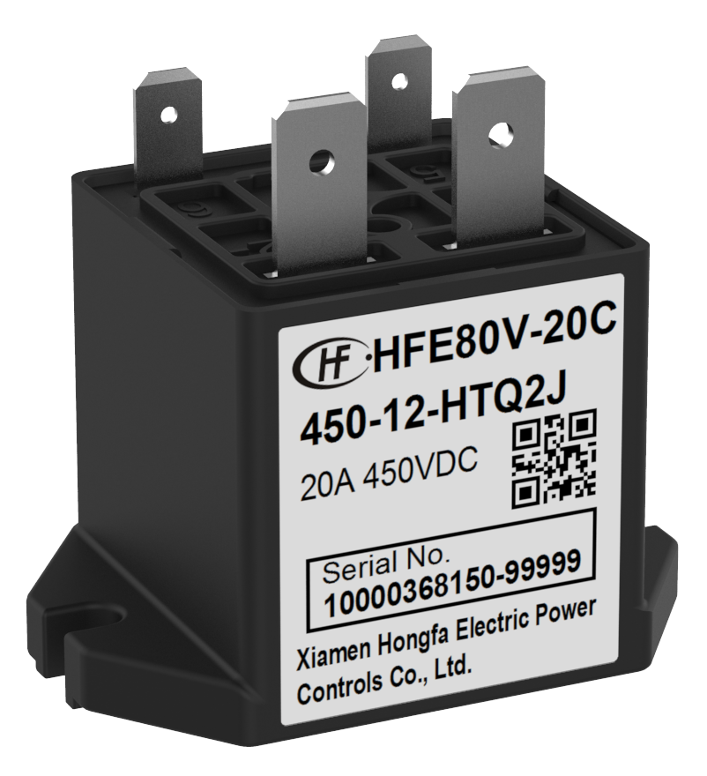
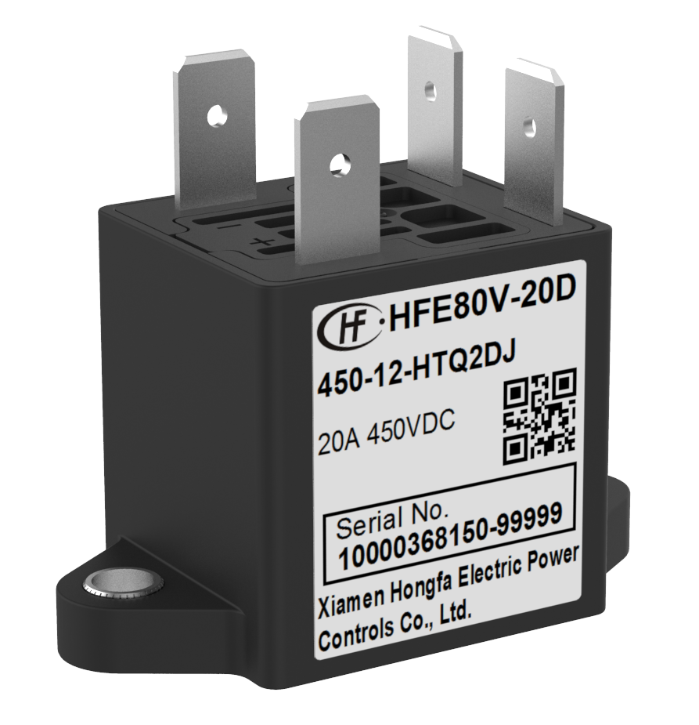
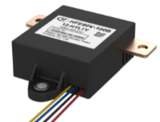
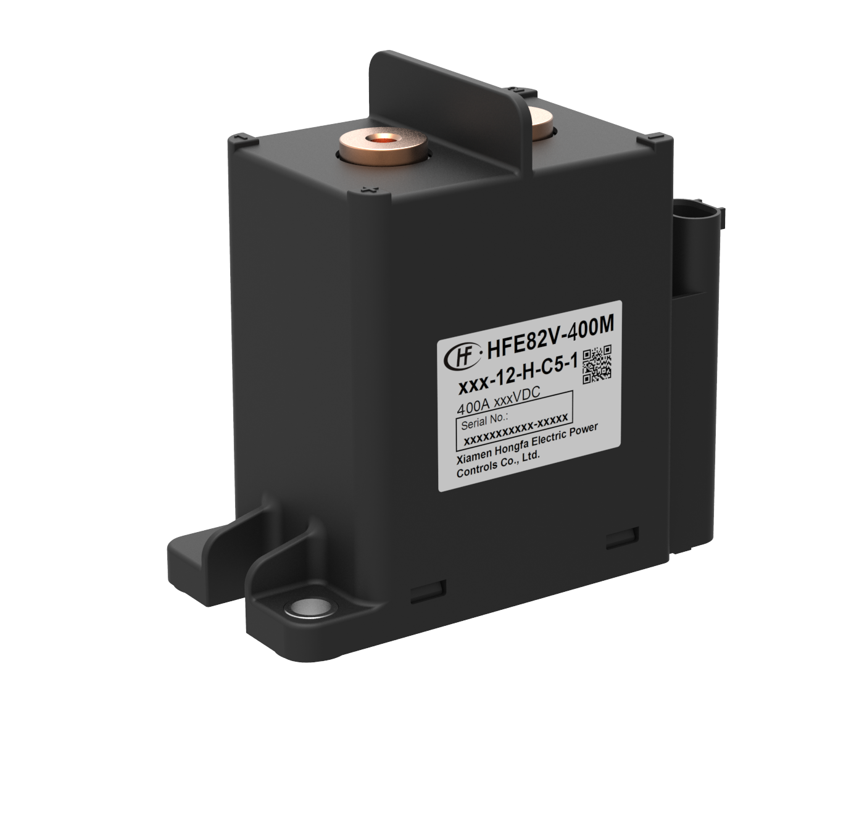
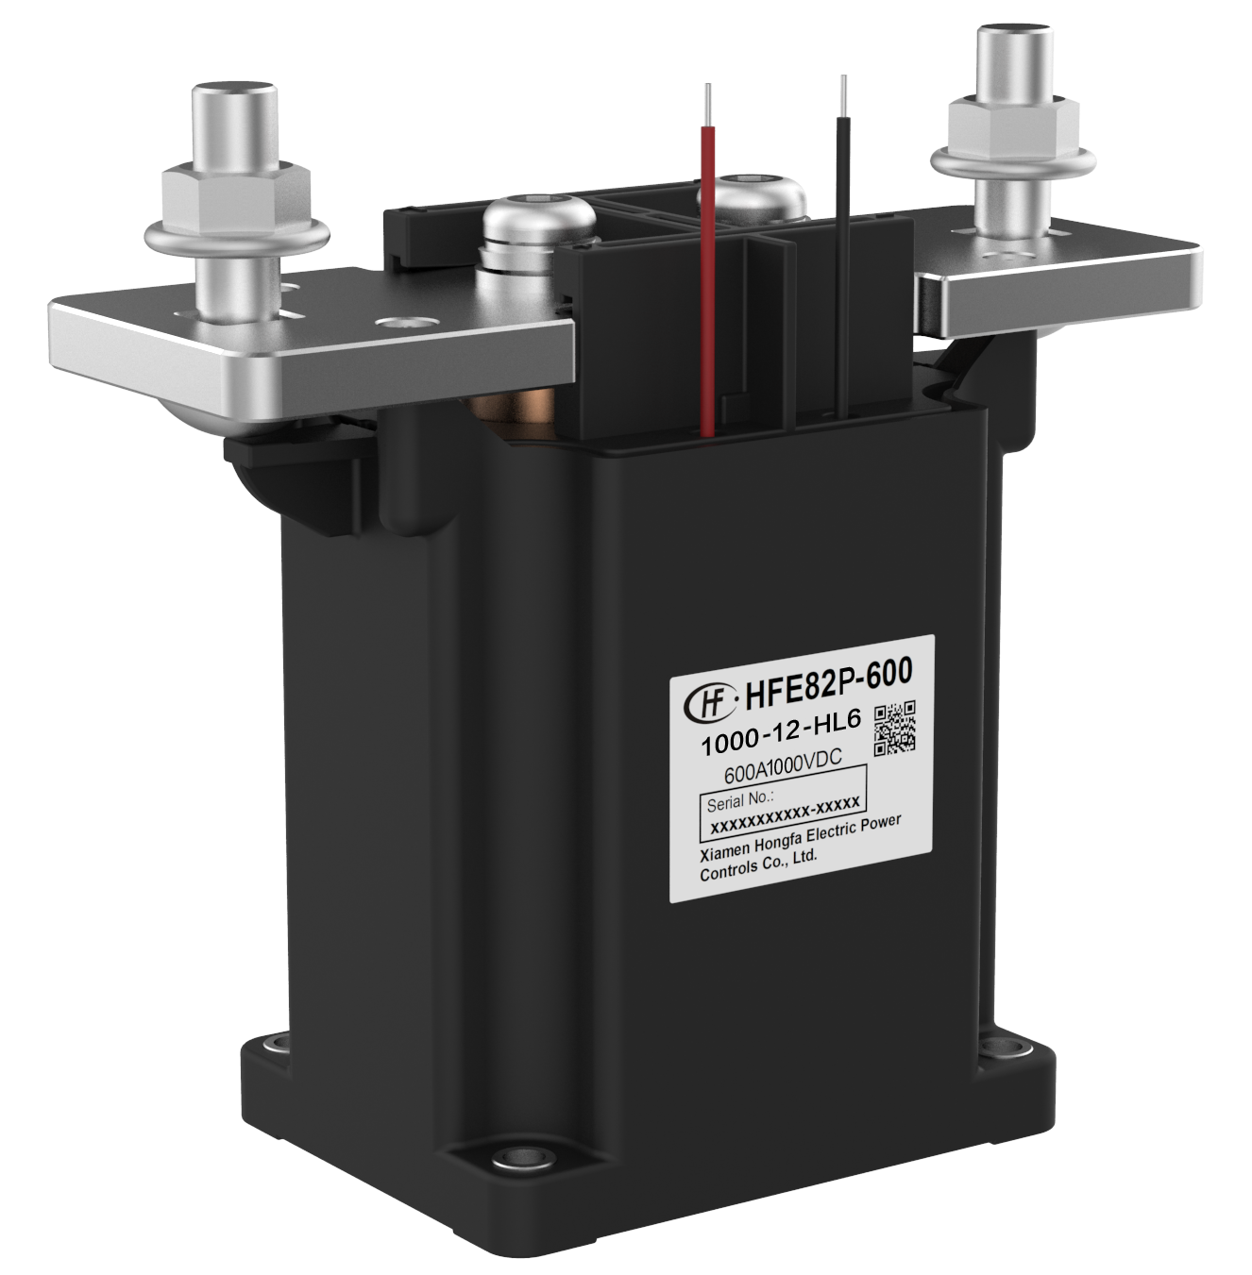
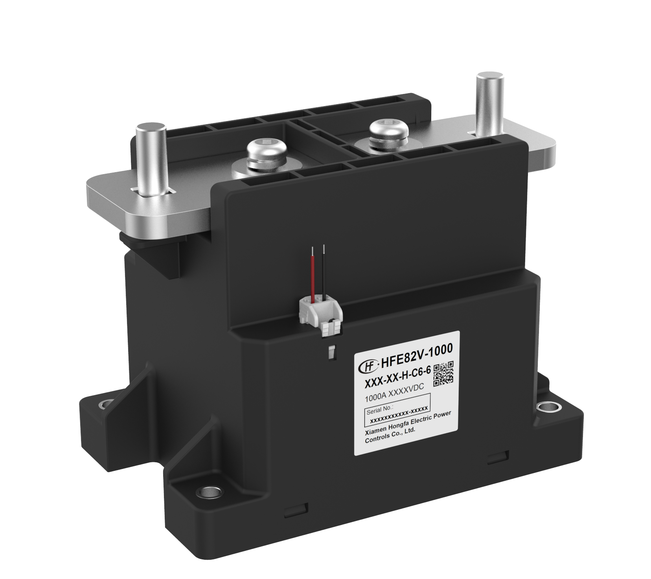
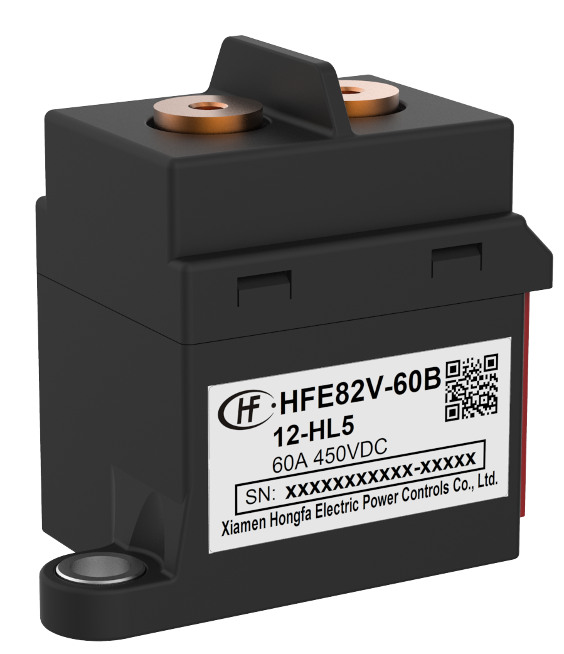
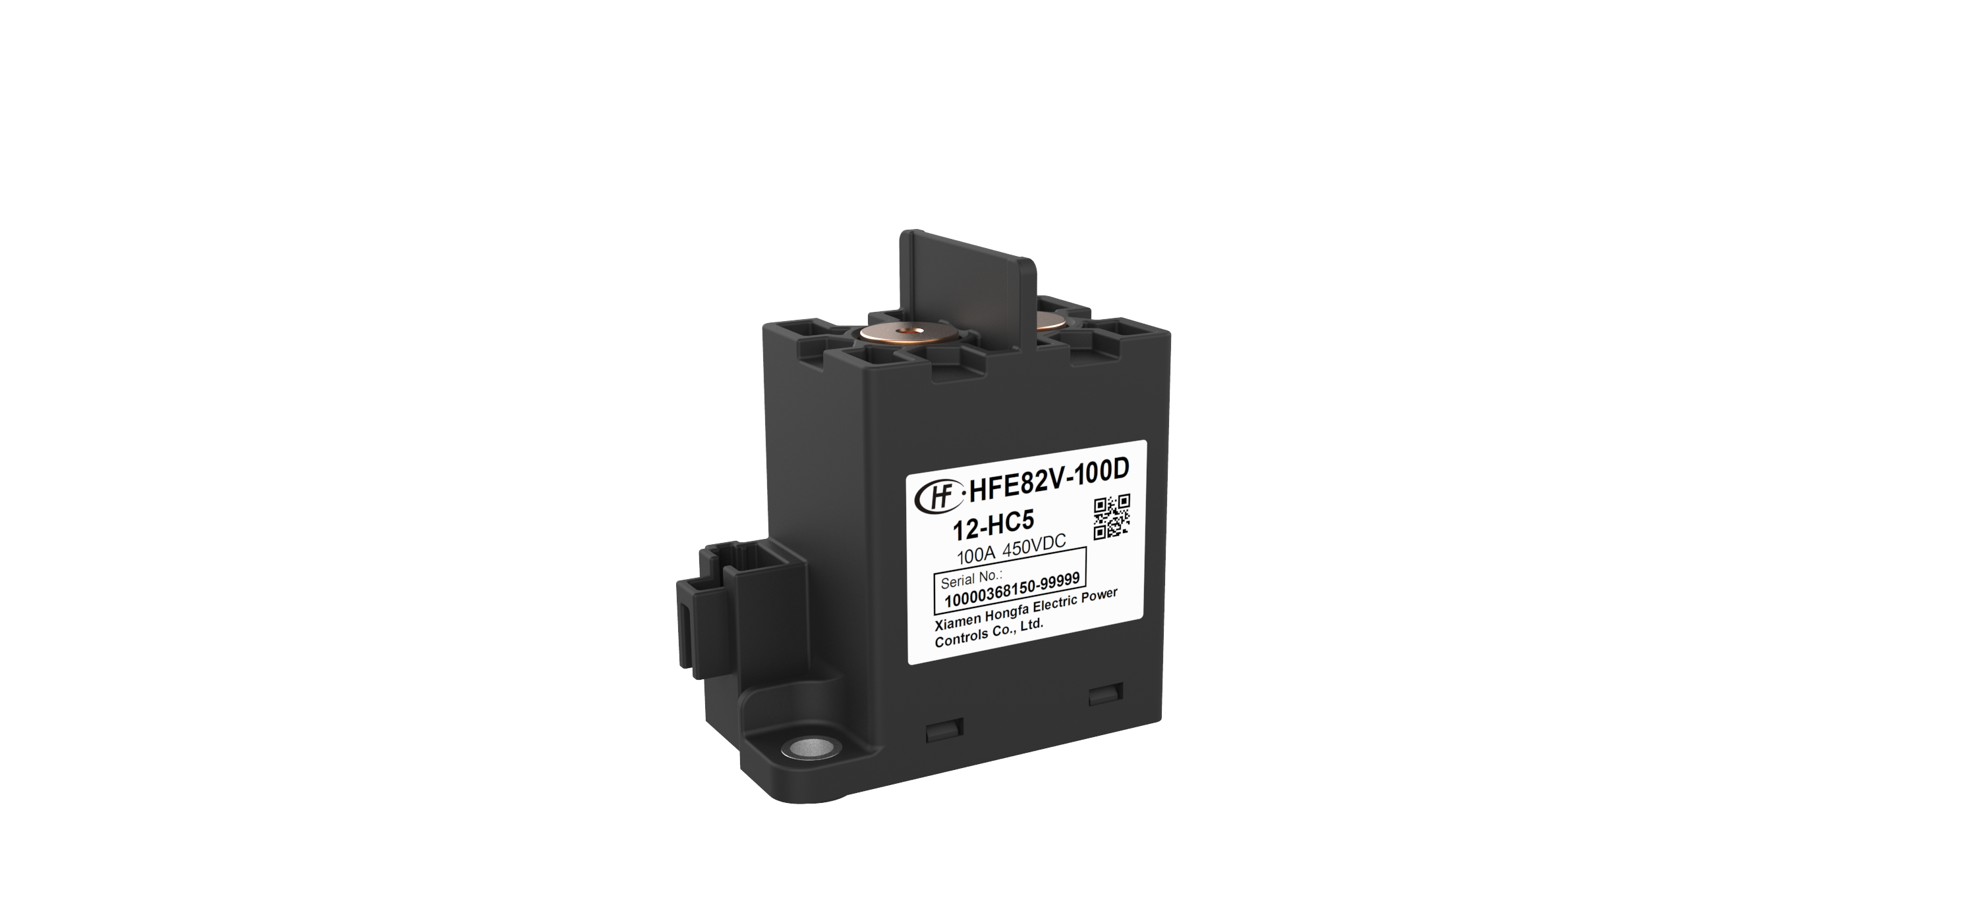
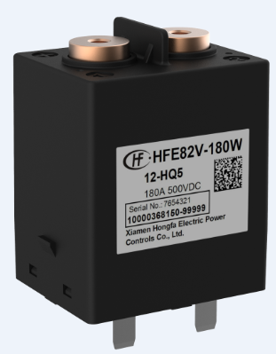
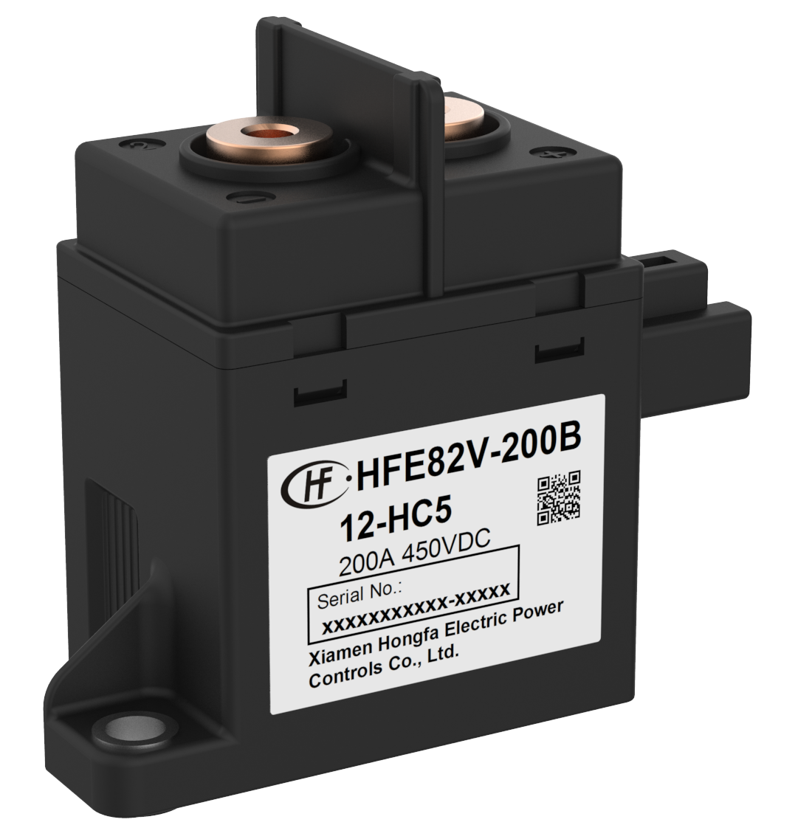
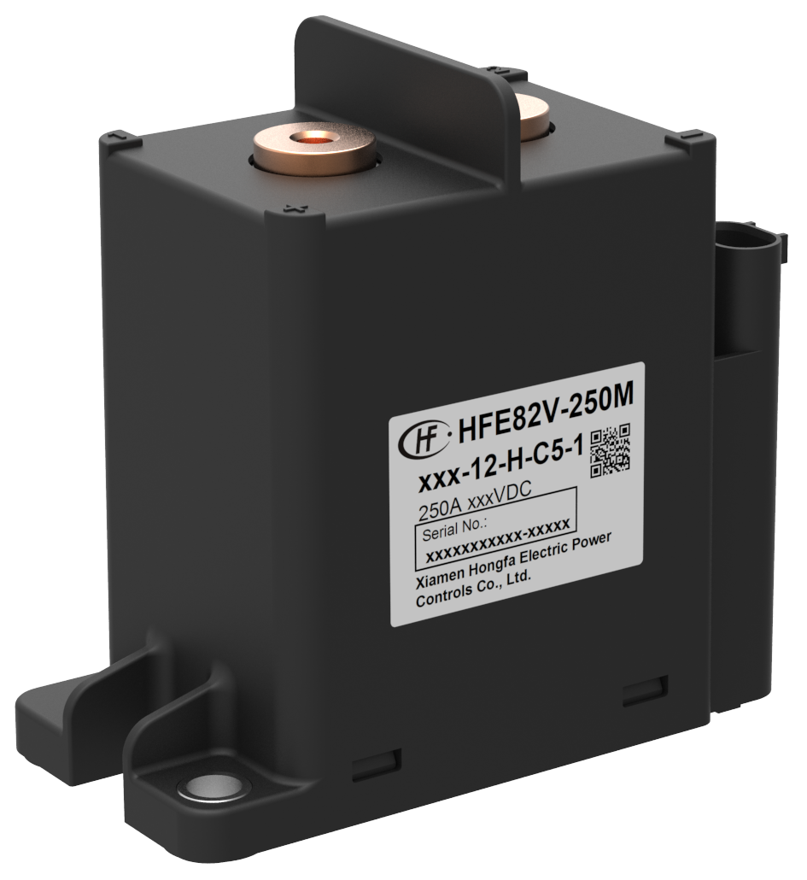
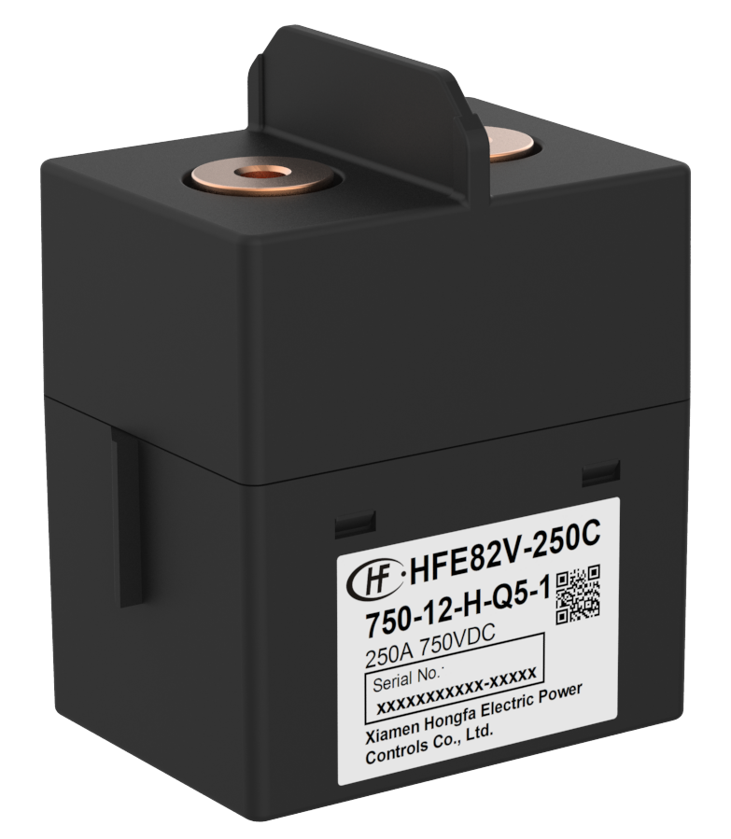
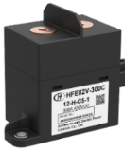
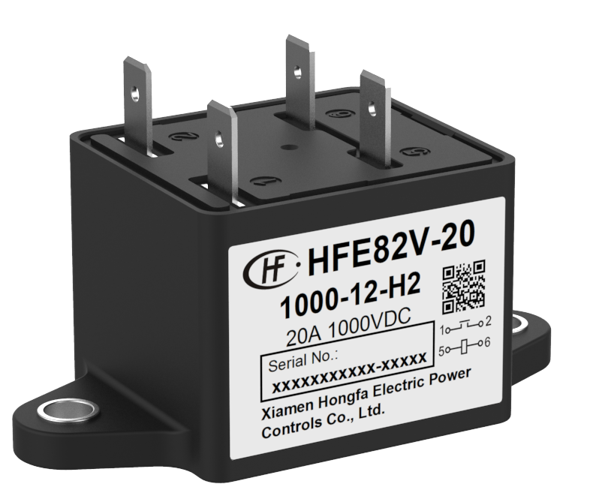
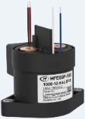
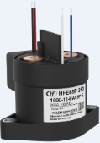
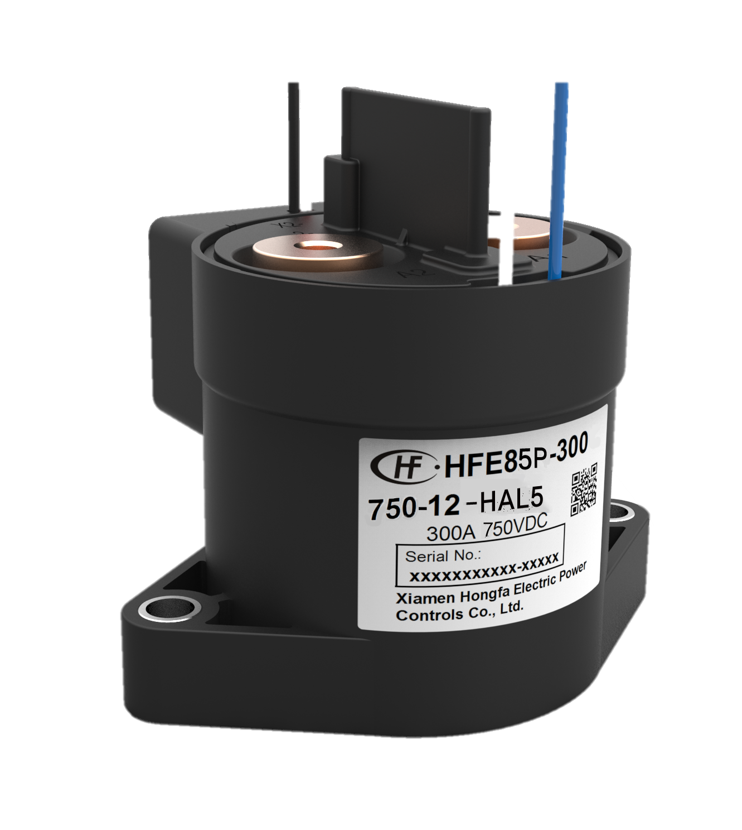





EV Charging
HVDC Relays
HFE80V-20 C/D
20A,450VDC
Simple structure, low cost
EV Car PreCharge, Aux. relay
HFE80V-100 B
100A,60VDC
Plastic sealed
48VDC application
HFE82V Series
Current 60A-600A
Ceramic chamber sealed
High SCC capability
EV Car Main relay, DC-Charge、
Aux.relay
HFE85P Series
150A/250A/350A 450VDC
Ceramic chamber sealed
Circular structure
PV&Energy storage Main relay
HFE85V Series
400A 750VDC
Ceramic chamber sealed
Circular structure
With auxiliary contact.
EV Car Main relay, Charge
HFE88P Series
150A/250A/350A 1500VDC
Ceramic chamber sealed structure, with auxiliary contact.
PV&Energy storage, Main relay
HFE82P-20F
20A,1000-1500VDC
Ceramic g sealed,
PV&Energy
Storage precharge application

Slide 15











EV Charging
Low Voltage Devices (LVD)
40A frame: 6-40A. 1P+N. Icu 4,5-6kA
63A frame: 6-63A. 1P, 1P+N, 2P, 3P, 3P+N, 4P. Icu 4,5-6kA
MCB
UEB6 series
Modular
Contactor
UEC1-GC series
MCCB
UEM5 series
32A frame: 16-32A. 63A frame: 40-63A. Up to 4 aux contact
16-800A, AC400-690V, Icu 35-100kA
IEC
Contactor
UEC1 series
18A frame: 9-18A. 38A frame: 25-38A. 65A frame: 40-65A. 95A frame: 80-95A. Up to 4 aux contact NO NC configurable

Slide 16
















EV Charging
Capacitors
HFLS1A
HFLS1B
HCBB62 X2
85°C and
85% humidity
HCBB65
Class A
30k hr Lifetime
HFLS1C
HFLS1D
HCDZFC
DC-Link
Capacitor
HFLS1E
HFLS1H
HCDLAE
AC-Filter
Capacitor

Slide 17

“EY estimates that the continent (EU) will need 65 million chargers to fuel 130 million EV by 2035”
*source: Automotive News Europe

Slide 18
Energy Storage

Slide 19










Energy Storage
Challenges with renewable Energy Sources
Renewable Energies are an integral part of the future energy mix
They are not always available when needed
Saving excess energy is important
Ranges from single family houses to industrial size storage system

Slide 20


Energy Storage
Design of a Home Battery
320-600 VDC
10-40A constant current
Up to 75A peak (5s max)
Mostly current carrying
Switching only in emergency or failure situations
Small contact resistance
Small coil power
All-pole disconnection required

Slide 21

„Electrical Energy Storages are a key element to a carbon free future and the installed base grows >35% per year.“

Slide 22


Energy Storage
The Application
Windpower /
Solar
DC
AC
Power Grid
Energy Storage Battery Side
Energy Storage PCS
Transformer

Slide 23



Energy Storage
HVDC- & Power Relays
Windpower /
Solar
DC
AC
Power Grid
DC Relay
1500V
Power Relay
1500V
HFE82P-20
HFE82V
HFE85P
HF161F-W
HF170F
HF186F
HFE88P
HFZ16
HFZ21
HF176F
HF172
HF167

Slide 24


Energy Storage
Capacitors & Signal Relay
DC
AC
Capacitor
Signal Relay –
HFD3
HCDA
HCSC
HCBB62-X2T
HCDB
HMMKP82
HMKP21
HCAB
HCAA

Slide 25



Energy Storage
Low Voltage Devices
Windpower /
Solar
DC
AC
Power Grid
UEM6H-400 2P MCCB
250-400A
750-1500Vdc
UEW6DHG-2500 2P
DC switch disconnector
800-2500A
1500Vdc
UEW6-4000 ACB
400-800Vac
1000-4000A

Slide 26


Energy Storage
Current Transformer
Windpower /
Solar
DC
AC
Power Grid
Current
Transformer
Hall effect type
Flux gate type
HCA001
HCA002
HCF2
HKC2T
HKCD001
HKCV003

Slide 27
Key Take-aways
We have experience in Electric Vehicle Charging- and Energy Storage System
Our Portfolio covers the entire range needed for EVC and ES Systems to:
  Secure Switching
  Protecting
  Measuring
  Filtering
We are working with the leading manufacturers of Charging and Energy Storage Systems

Slide 29
5 Questions / Answers
What is the leadtime on that remarkable HF187F(955)? A: 15 weeks production leadtime
Do you have free samples available of the HF187F(955)? A: Yes, samples are available from stock
Are further developments planned for the EV market A: Yes, Hongfa carefully listens to the market and its customers. Get in contact with your local sales for further information.
How is Hongfa reacting to the increasing demand in HV Relays? A: Hongfa continuously invests in new capacity.

